Slide 1

Credit EDA Case Study
PGC Data Science
Submitted By: Ashish Sharma (CDS2010025)
Date : 22nd July 2020

Slide 2




Introduction & Problem Statement
TASK
TASK
TASK
TASK
1
2
3
4
Apply EDA
Business Understanding
Business Objectives
Output
Use EDA in a real business scenario of risk analytics in banking
Applicants capable of repaying the loan should not get rejected.
Identify patterns which indicate if a client has difficulty in repayment
Report the driving factors (Variables) and their impact on loan default

Slide 3
Conclusion :: Default Driving Factors :: Strong Indicators
Service Tenure
Region
Var-DAYS_EMPLOYED
Negative Correlation 0.075
6
1
Var- REGION_RATING_CLIENT
Positive Correlation 0.059
♗
♘
♛
Age
Correlation with TARGET Variable
TARGET = 0 (Non Default)
TARGET = 1(Default)
City
5
2
Var-DAYS_BIRTH
Negative Correlation 0.078
Var-REGION_RATING_CLIENT_W_CITY
Positive Correlation 0.061
♖
♙
External Agency Score
External Agency Score
4
3
Var-EXT_SOURCE_3
Negative Correlation 0.179
Var-EXT_SOURCE_2
Negative Correlation 0.160
♔
♜

Slide 4
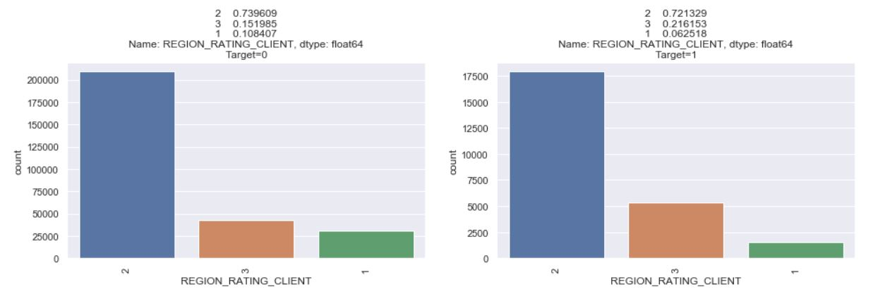
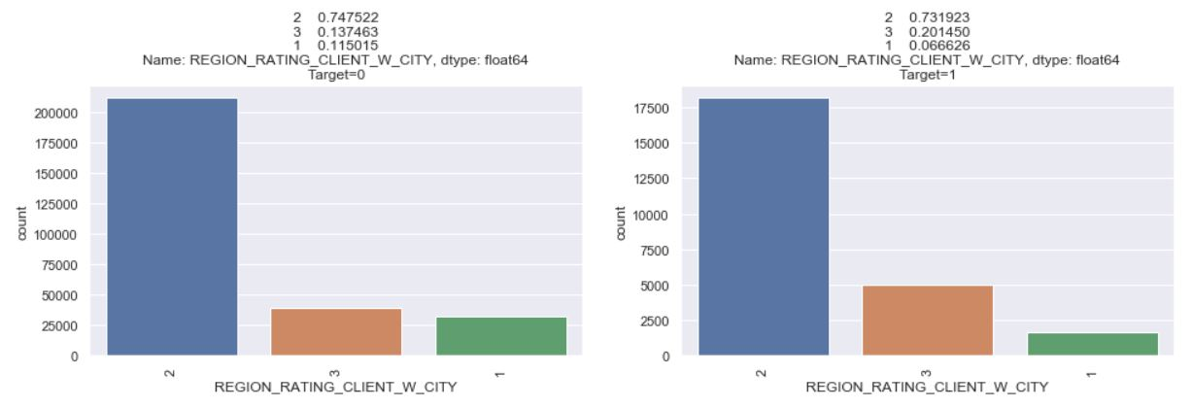
Default Driving Factor :: Strong Indicators
1. Region
As it is clearly indicated in the bar chart that for loan default the % increase in applicant residing in region with rating 3 is ~6.5%. This indicates that applicants residing in region with rating 3 are more likely to default on loan repayment.
2. City
As it is clearly indicated in the bar chart that for loan default the % increase in applicant residing in city with rating 3 is ~6.3%. This indicates that applicants residing in city with rating 3 are more likely to default on loan repayment.

Slide 5
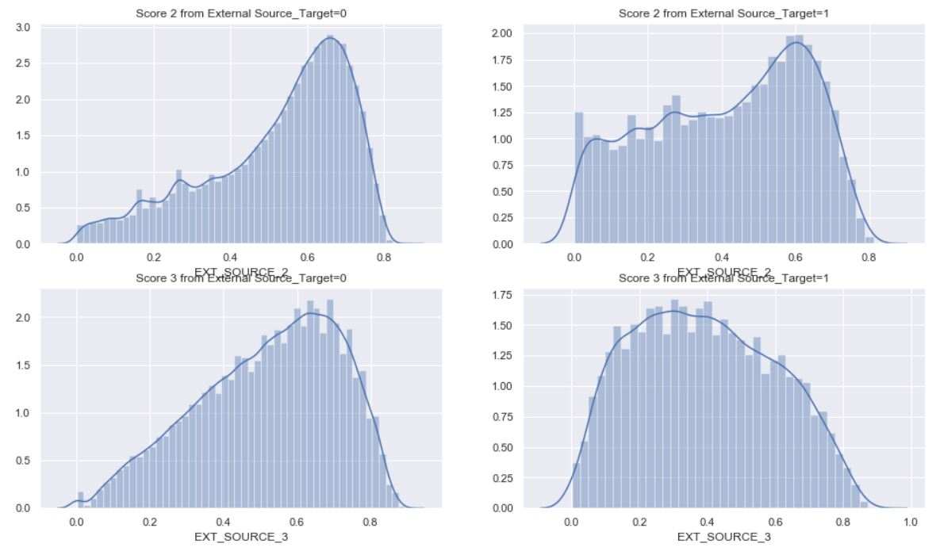
Default Driving Factor :: Strong Indicators
3. External Score2
While comparing the plots, it is indicated that for loan default cases there is an increase in the population density below external agency score 2 of 0.4. So, the applicants with low external agency score more likely to default.
4. External Score3
While comparing the plots, it is indicated that for loan default cases there is an increase in the population density below external agency score 3 of 0.4. So, the applicants with low external agency score more likely to default.

Slide 6
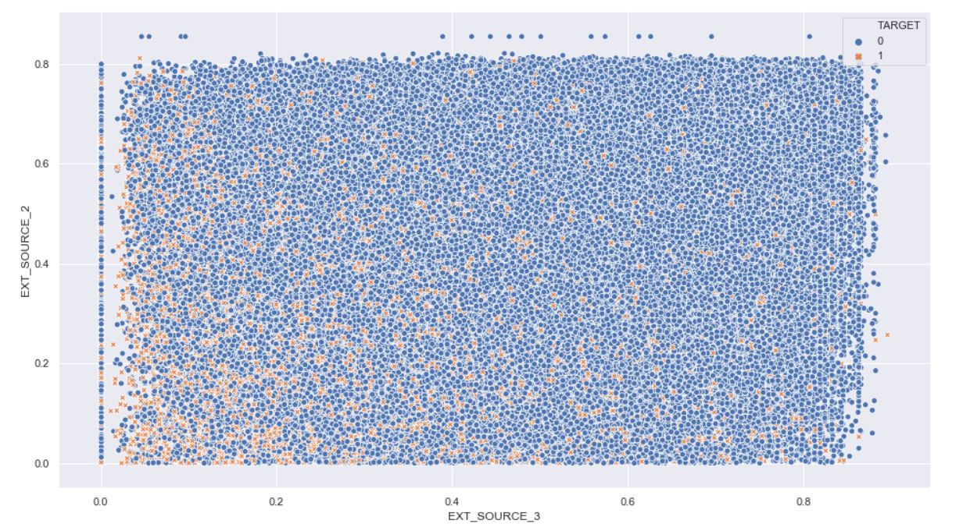
Default Driving Factor :: Strong Indicators
3 & 4.
External Agency Scores(Combined)
In the scatter plot its is clearly indicated that for loan default cases(TARGET=1) the both external agency scores are accumulated at the left bottom corner of the scatter plot. This again further strengthen our claim that lower the external agency score , higher the chances of applicant defaulting on loan repayment.

Slide 7
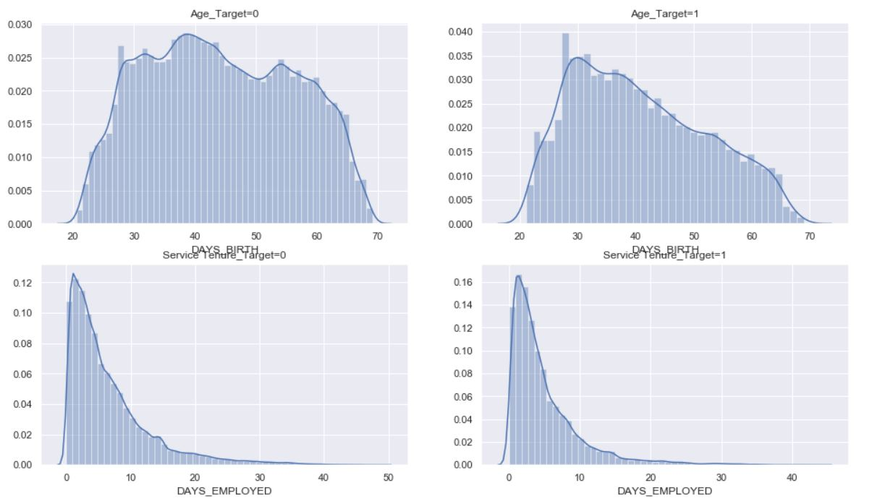
Default Driving Factor :: Strong Indicators
5. Age
While comparing the plots, it is indicated that for loan default cases there is an increase in the population density for applicant below age of 30 years, So, the young applicants of 20 to 30 years of age more likely to default.
6. Service Tenure
While comparing the plots, it is indicated that for loan default cases there is an increase in the population density for applicant with service tenure below 2 years So, the applicants with less work experience more likely to default.

Slide 8
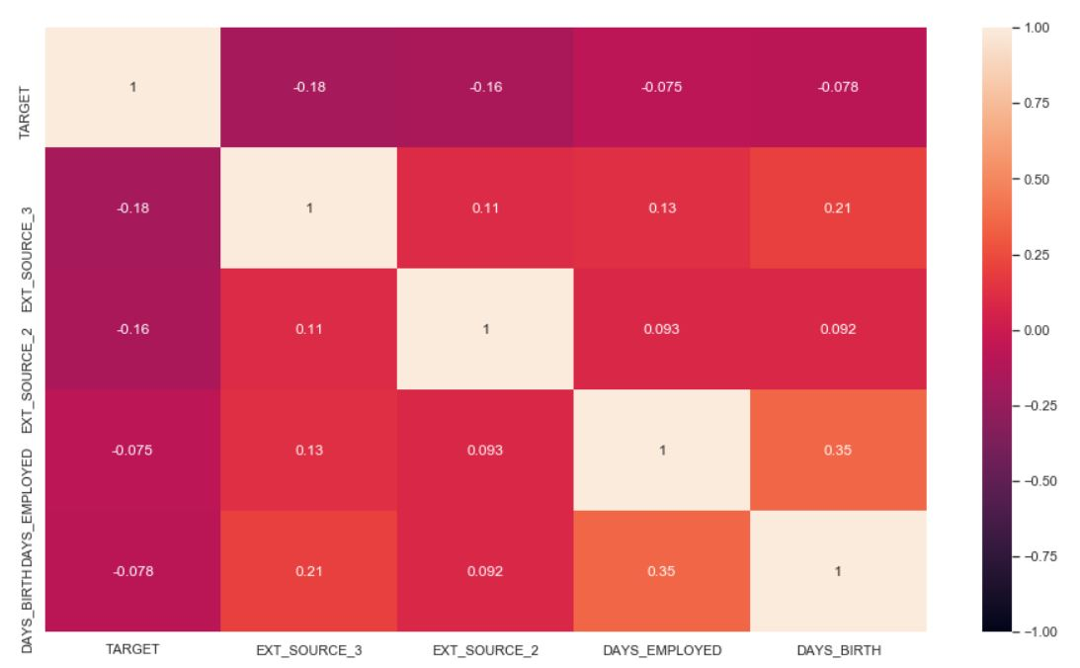
Default Driving Factor :: Strong Indicators
Correlation of continuous variables with TARGET Variable
-ve Correlation :- This means with decrease in the value of these variables the chances of client defaulting on loan increases
1. EXT_SOURCE_3 -0.178898
2. EXT_SOURCE_2 -0.160453
3. DAYS_BIRTH -0.078232
4. DAYS_EMPLOYED -0.074952

Slide 9
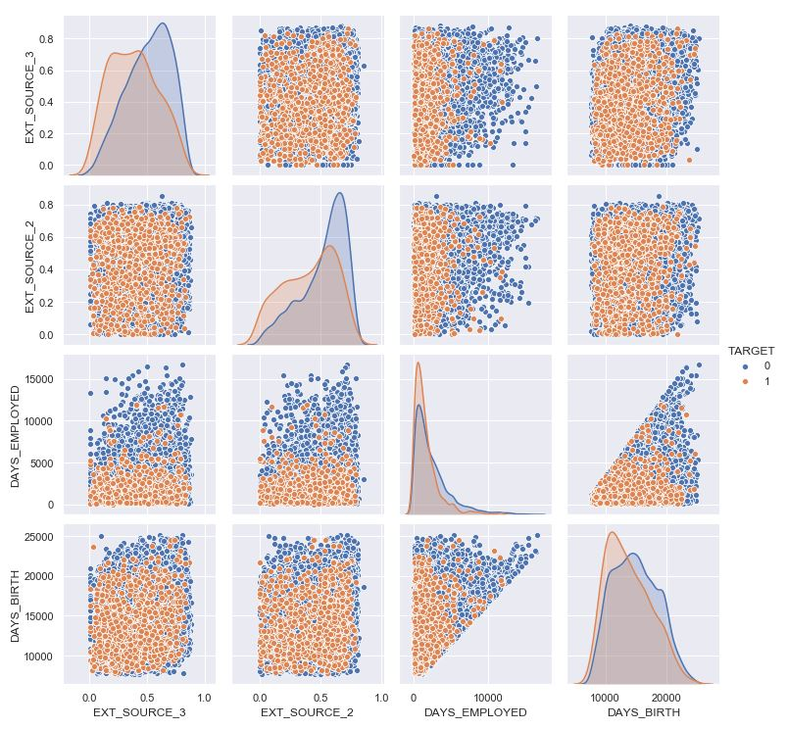
Default Driving Factor :: Strong Indicators
Correlation of continuous variables with TARGET Variable:
Pair Grid
In the pair grid, it is visibly clear that for the cases of loan default all the continuous variables are accumulated a the left bottom corner of the scatter plots. This essentially means that lower the values odd continuous variables higher are chances that the respective applicant will default on loan repayment.
Further, to strengthen our claim, the population density of the distribution plots also confirms that for cases of loan default the density population shifts tower lower values.

Slide 10
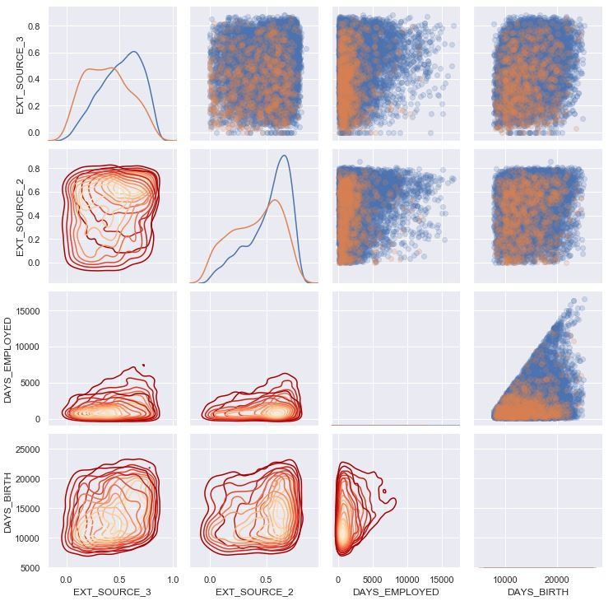
Default Driving Factor :: Strong Indicators
Correlation of continuous variables with TARGET Variable:
Density Plots
In the Density Plots, it is visibly clear that for the cases of loan default all the continuous variables are accumulated a the left bottom corner of the scatter plots. This essentially means that lower the values odd continuous variables higher are chances that the respective applicant will default on loan repayment.
Further, to strengthen our claim, the kde plots also confirms that for cases of loan default the density population shifts tower lower values.

Slide 11
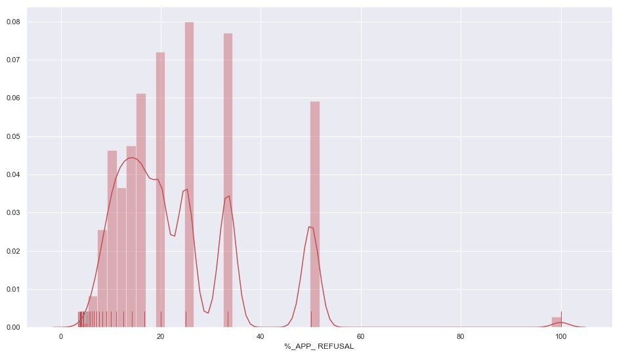
Default Driving Factor :: Strong Indicators
7. Rejection Rate of Previous Applications
The %_APP_Refusal variable derived from previous application data and mapped with the current application data. It has a +ve correlation with TARGET variable (0.054).
We understand that if out of the total loan applications made by applicant in the past, if more than 20% has been rejected by the bank, then the applicant is more likely to default on loan repayment

Slide 12
Default Driving Factor :: Mild Indicators
Family Size
Loan Type
Var-CNT_FAM_MEMBERS
People with smaller families are more likely to default
6
1
Var- NAME_CONTRACT_TYPE
Cash Loan more
prone to default
♗
♘
♛
Children
Based on trends & distributions identified during Univariate Analysis
Gender
5
2
Var-CNT_CHILDREN
People who don’t have children are more likely to default
Var-CODE_GENDER
Male borrowers more
prone to default
♖
♙
Marital Status
Education
4
3
Var-NAME_FAMILY_STATUS
Single people more likely to default
Var-NAME_EDUCATION_TYPE
clients with secondary education are more prone to default
♔
♜

Slide 13
Recommendations to the Bank::To Minimize Loan Default
Based on the extensive EDA conducted on the data set and our professional judgement based on the finding of the EDA, we recommend the Bank implement a 4 layer scrutiny system in order to minimized loan default. These layers will refine the applicants profile based on the following 4 checks and the applicants profile matching all 4 checks can be rejected.
CHECK
CHECK
CHECK
CHECK
1
2
3
4
Age & Service Tenure
Region & City
External Agency Scores
Past Rejected Applications
Avoid giving loan to applicants with age<30 years &
job tenure<2 year
Avoid giving loan to applicants who resides in region & city with rating 3 assigned by bank
Avoid giving loan to applicants with external agency score less than 0.4
Avoid giving loan to applicants with more than 20% past applications rejected by bank

Slide 14


